Slide 1
Subway POS System
Name: Sameer Ullah Khan
Roll No.: 19B-068-CS
Sec: CS-B
Course Title: Object Oriented Programming
Course Instructor: Sir Faisal Ali

Slide 2
INTRODUCTION
Object Oriented Programming: OOP refers to a type of software which is design in which the program offers a solution using objects, classes and their functions which operate with different types of data structure.
Inheritance: Inheritance is when a class uses code constructed within another class. The class which has an inheritance is known as Parent and its child class. The child classes inherit all the methods and attributes from parent class or main class.
Multi Inheritance: The simplest and most useful form of the multiple inheritance is called a mixing. A mixing is generally a superclass that is not meant to exist on its own but inherited by someother class to provide extra functionality. A multiple inheritance is when a meant to be main class is inherited by multiple sub classes.
Abstraction: Abstraction in python refers to abstract classes that behave as template for its sub-classes. A classes which contain one or more abstract methods is called an abstract class. It may not be instantiated and objects are created only for its sub-classes.

Slide 3
POS System
A POS system is basically a Point Of Sale System which is used to place a order by a customer. This program is really helpful for the cashiers to add items, set their quantity and it will calculate the total with other set charges and then print all the entire set data and information in the receipt section and it print a slip for the user.
Before this POS system the cashier has to write all the items and quantity and has to calculate it manually but in this program all the calculations are predefined and ready to use so we should select values and quantity and it calculate it by itself.

Slide 4
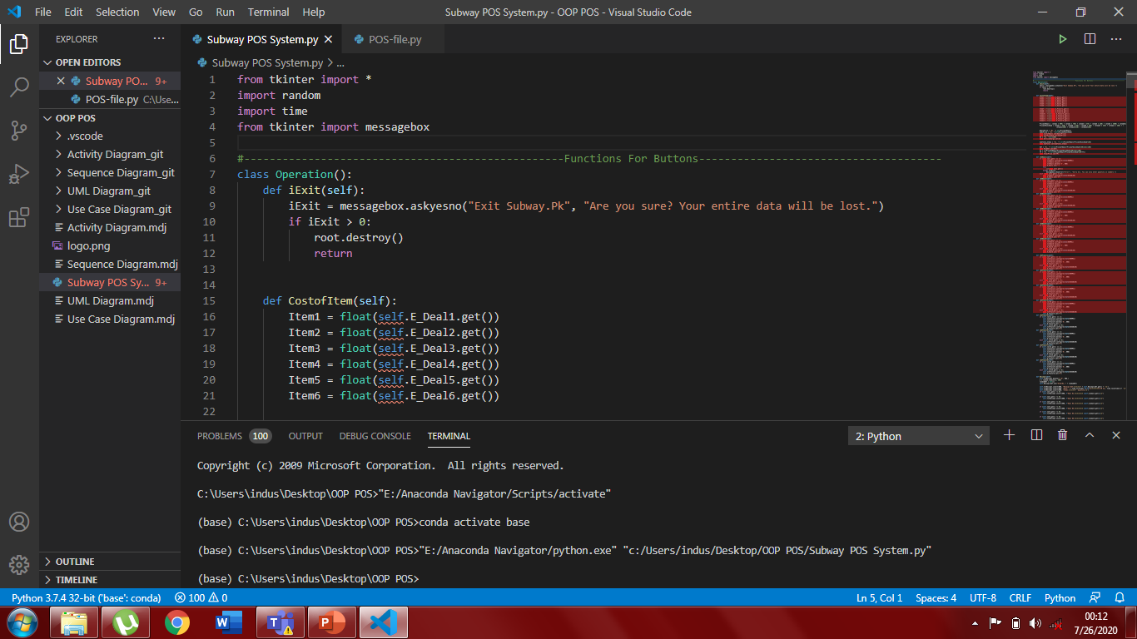
IMPORT LIBRARIES
In this piece of code we just simply import different libraries of gui, random and time to use it in the code. Messagebox is also imported for exceptional handling and for exit function.

Slide 5
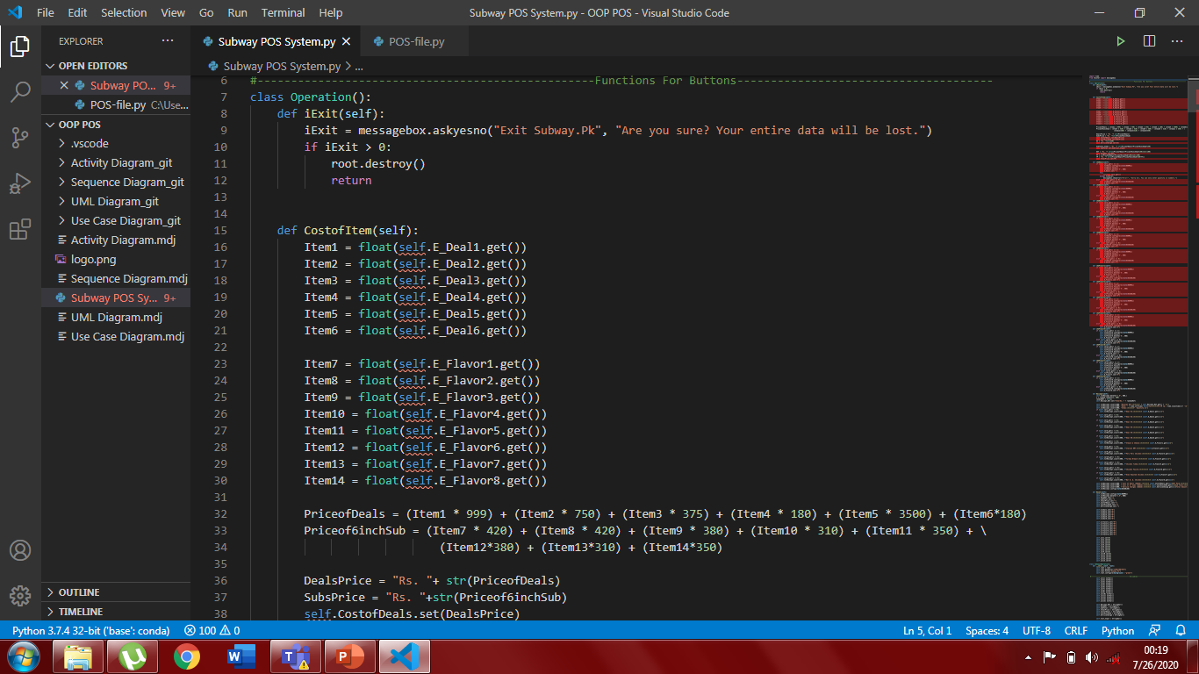
In this part we declare the main class of code. The main objective of this class is to define functions which are commanded on the buttons to acquire the output. We can see 2 functions in this part iExit() is used to exit the program. At first it shows a messagebox to confirm the operation and then it destroy the window. In CostofItem() we performed all the calculated operations to calculate Sub Total, with GST and Service Charges and Total Price. For every Deal and for every Flavor we Declare chkDeal to perform functions on the check button of Deals and Flavors.

Slide 6
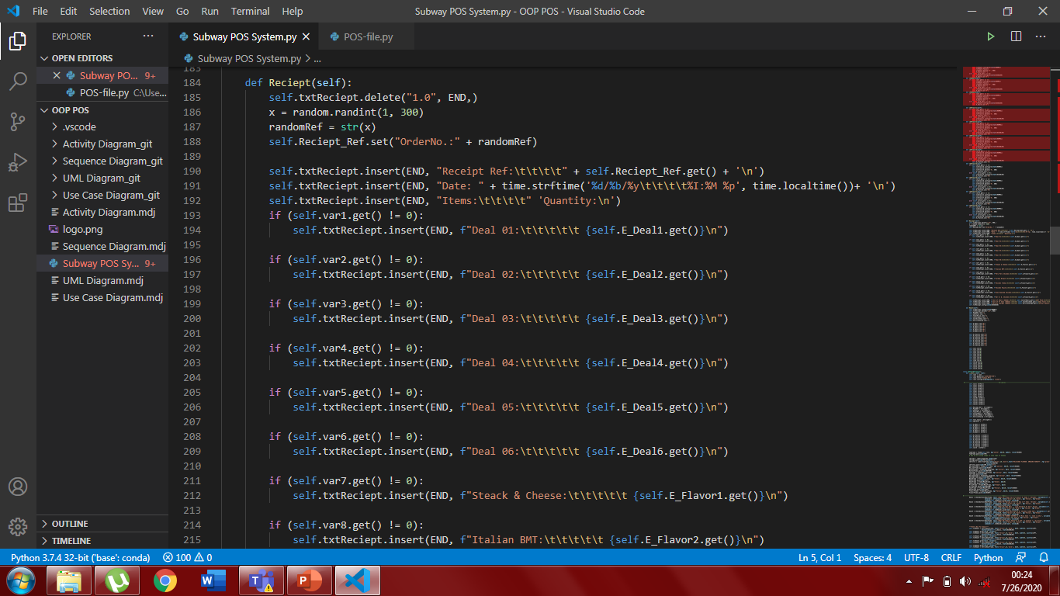
In this function we call the variables set for Deals and Flavors. The main objective of Reciept() is to print all the given values and calculation in the form of receipt and its command is given on the Reciept button to call is on the button click. This will print all the required items and total in the text area assigned for receipt.

Slide 7
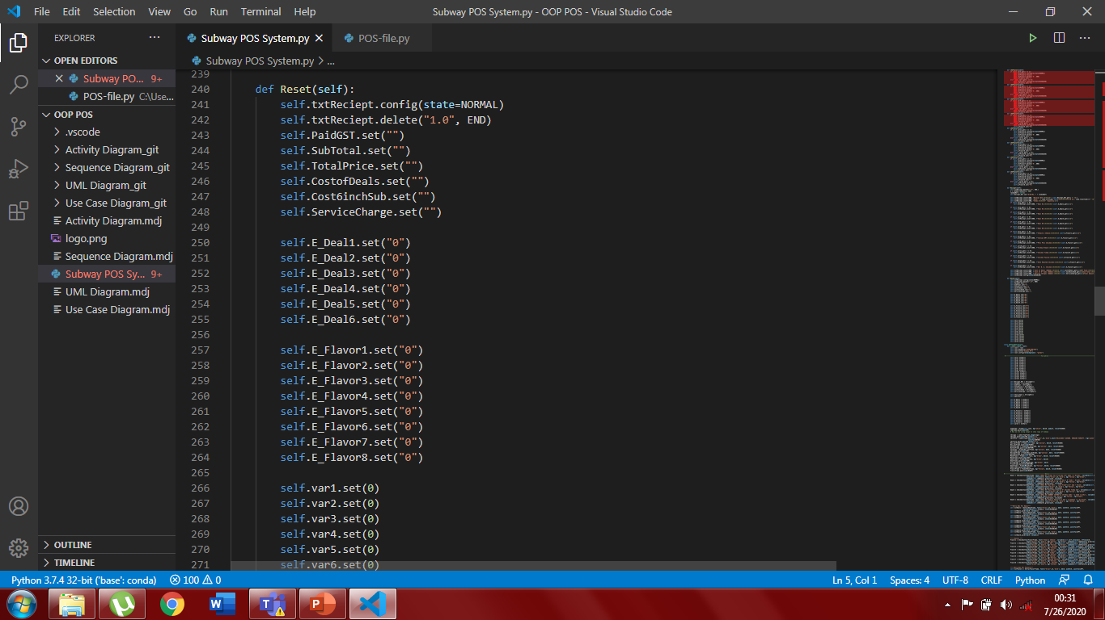
In this function we just assign all the variables as it was given in the start it will delete all the calculations and all the values will set to 0 after pressing this button. This function was called in the Reset button given in child class and the main objective is to set the value of variables 0.

Slide 8
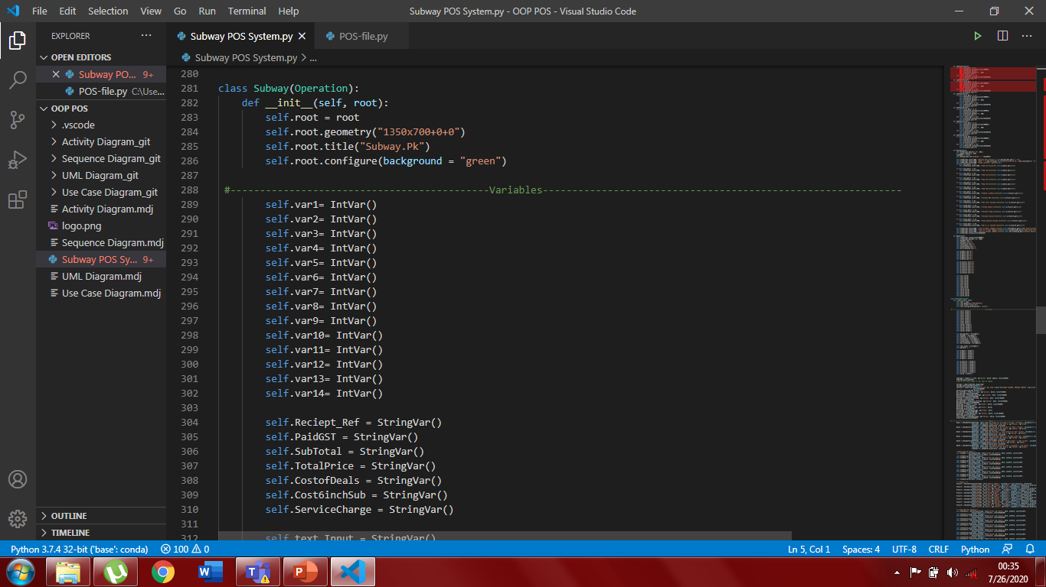
This is the child class Subway of the parent class operation and initialize the code. We declared root as an argument in the class and in the beginning we define geometry and title of the class. The inheritance perform all the functions from the main class. In the next part of this code we declared variables as VarInt() and StringVar().

Slide 9
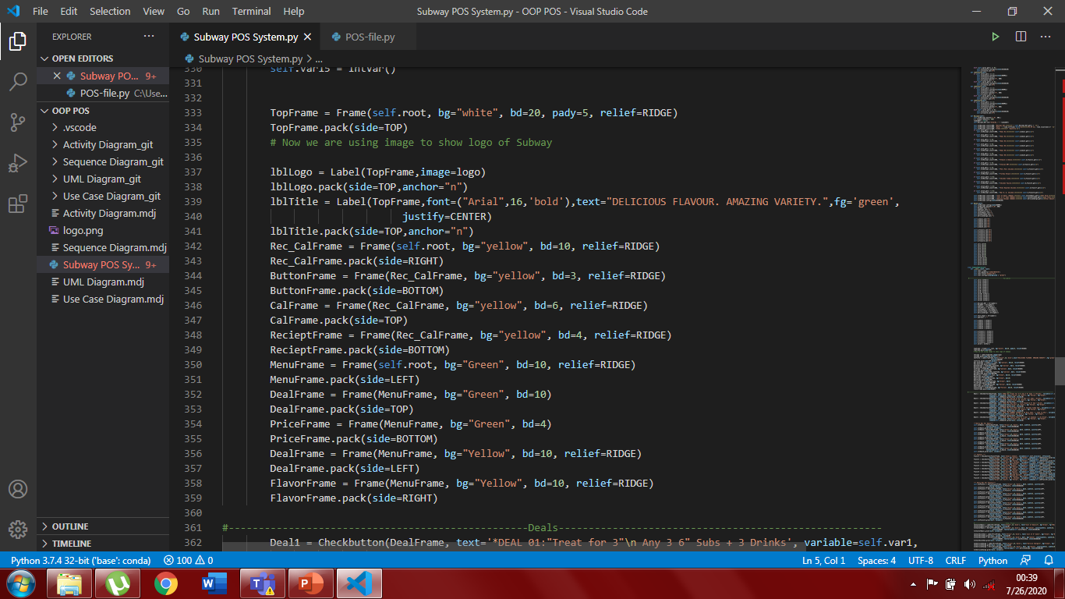
In this part we declare different frames in the window lie TopFrame, DealFrame, FlavorFrame, Rec_CalFrame, ButtonFrame, RecieptFrame, CalFrame. Frames are basically used to divide the window into different parts to enter data into it. If you already worked on HTML5, so as there are different divs to divide the webpage. Similarly in python we use frames to divide the program window into different partitions.

Slide 10
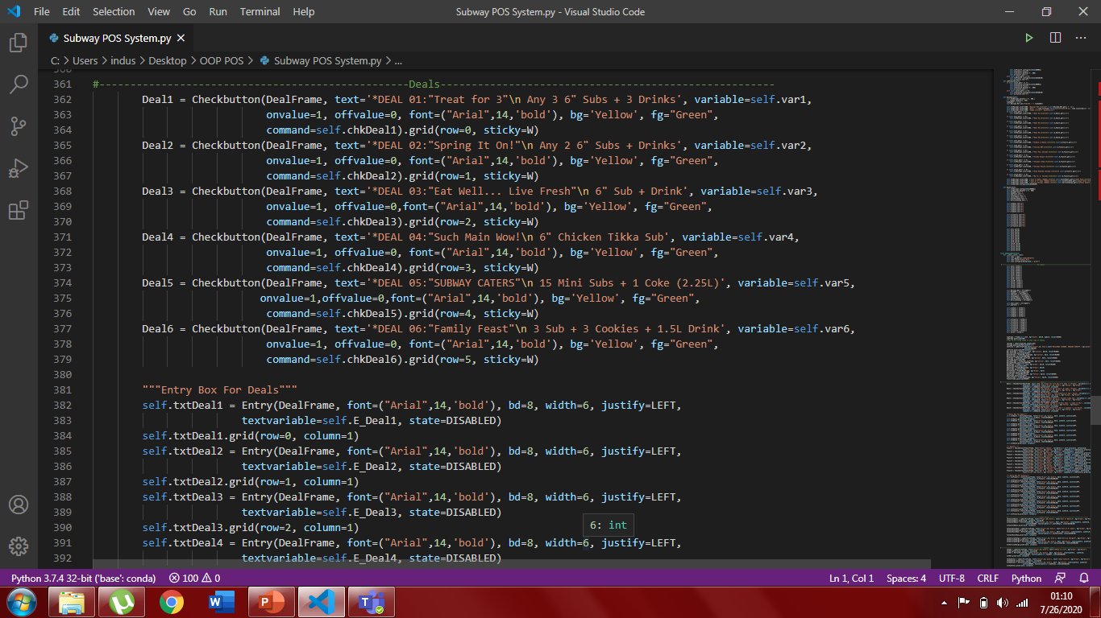
In this step of code we made checkbuttons and entry widget in the deal and flavor frame and give them different texts which were shown on the program. We just assign this checkbuttons different varialbles and store its value in a different variable. In the code of entry box you can see that I declared the state of entry box disabled so no one can write anything in that code and if the check button in on then you can write quantity in integers. This code is done to give names of deals and flavors.

Slide 11
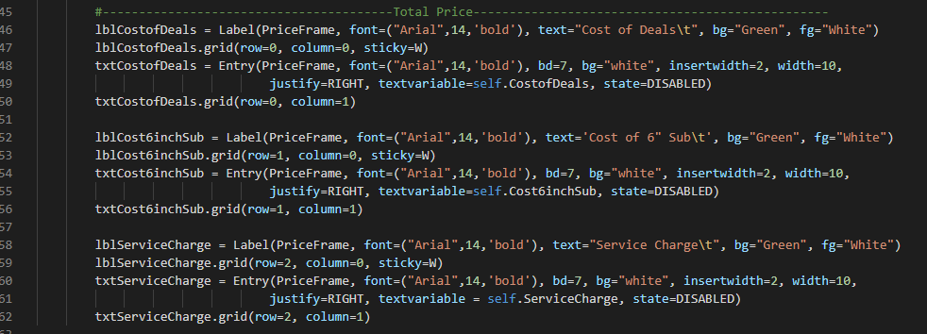
In this part of the code we made labels and entry box just below the deal and flavor frame. This work was done in price frame and in this frame we took labels like cost of deals, cost of 6” inch sub, service charge.It is the left part of the price frame and we made three entry widgets with label in it. We also give a entry box in front of these labels where the value should be printed after running the function and this value is calculated.

Slide 12
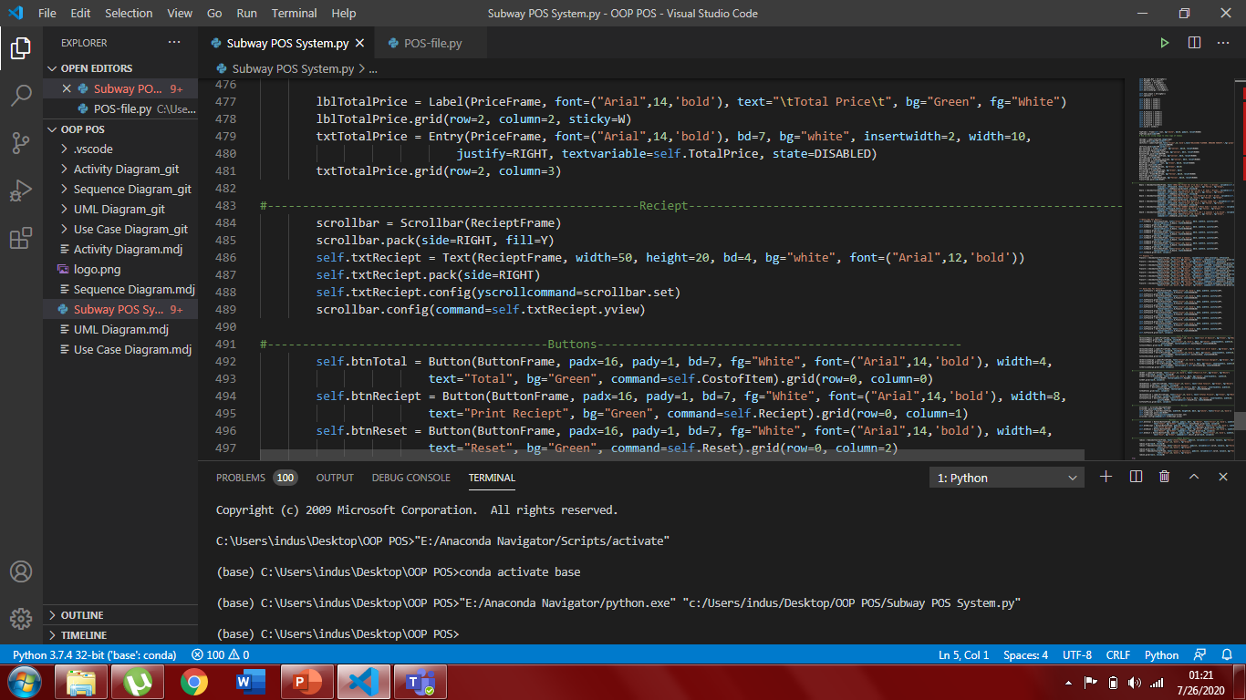
In this part we declare a text area for the receipt section where the receipt should be printed. This work is done in a receipt frame. If the customer take many items to order so we can not scroll to see the grand total which was printed in the last in the function Reciept(). So to solve this proble we made a scrollbar to move this frame vertically and to see the complete printed receipt with the complete placed order in it.

Slide 13
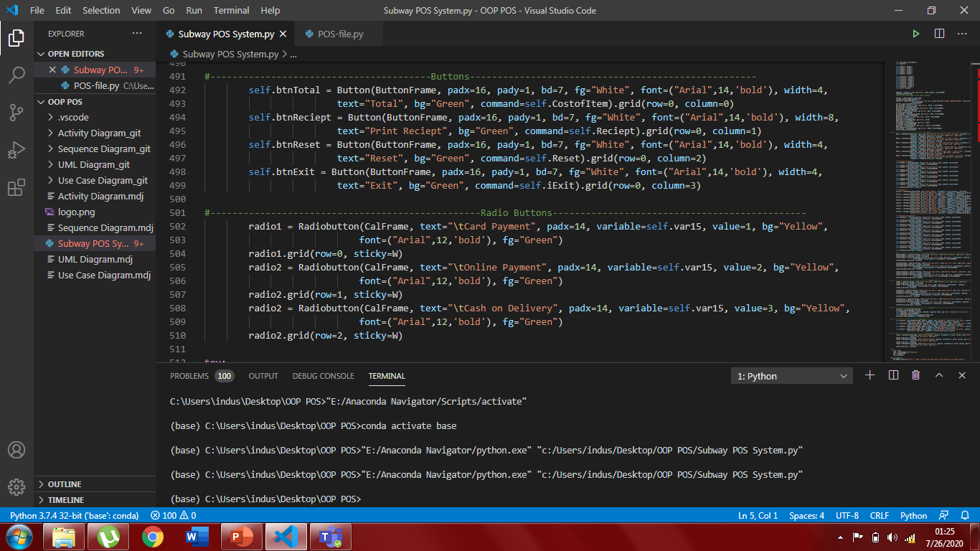
In this part, we made for buttons namely Total, Receipt, Reset and Exit. This 4 buttons are assigned with 4 different functions we declared in main class (Operaton) and inherit those functions in this child class and call those 4 different functions using these buttons. All these buttons have their own assigned work to do.
In the end of the code we made three radio buttons to know the payment method of the customer. We can not use check box here as you can select various check box in a time but radio button is allow to get only one value.

Slide 14
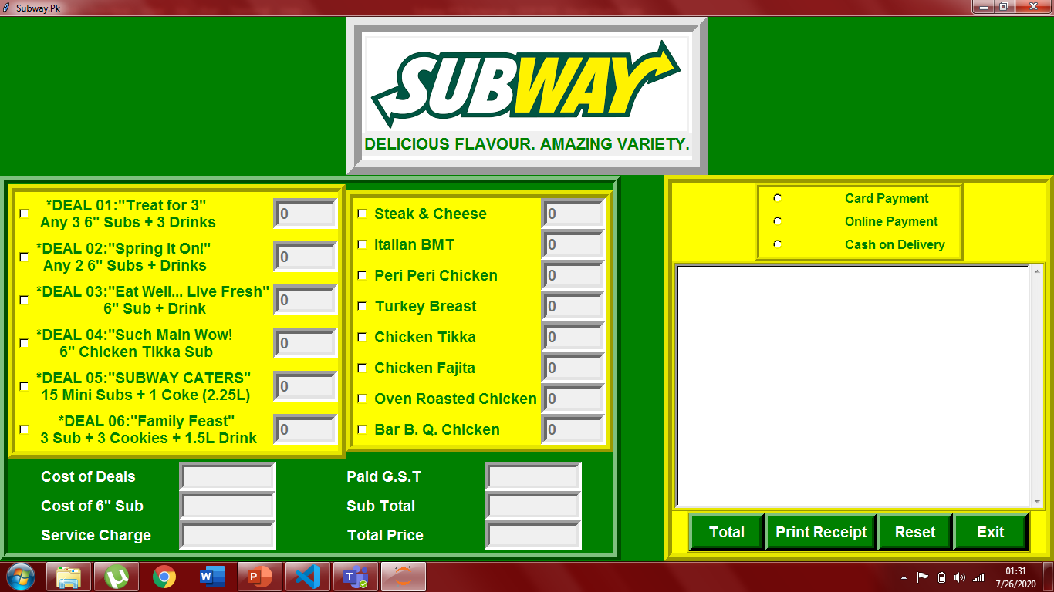
OUTPUT In the ending part we call the class using a object and apply window.mainloop to start the program

